Slide 1
Deep Learning Fundamentals

Slide 2
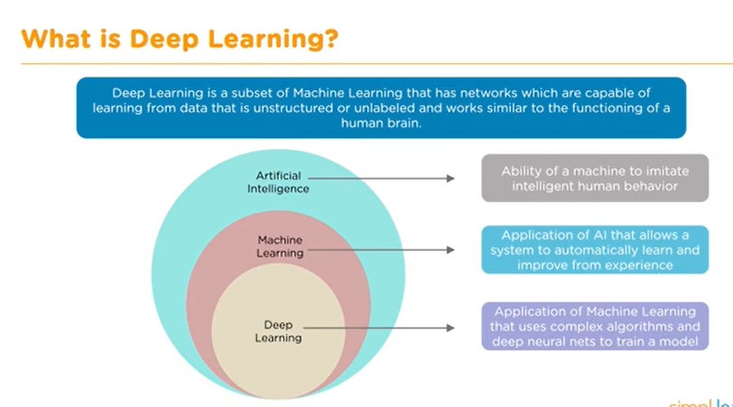

Slide 3
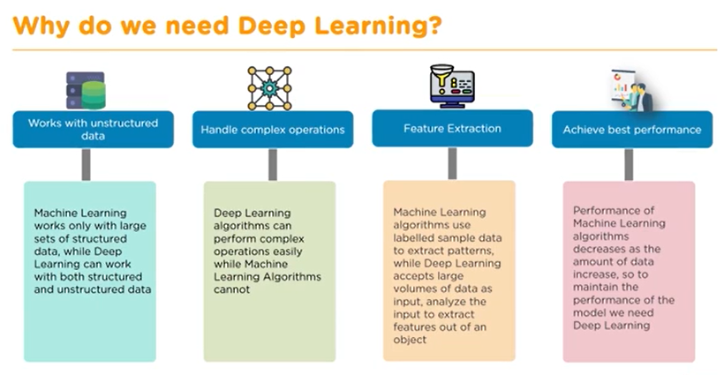

Slide 4
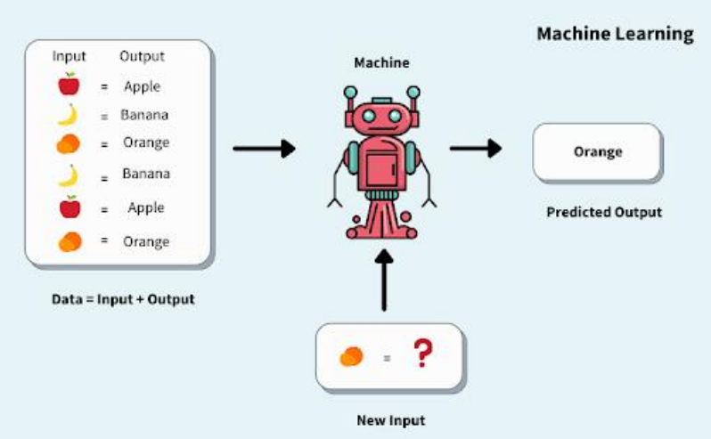

Slide 5
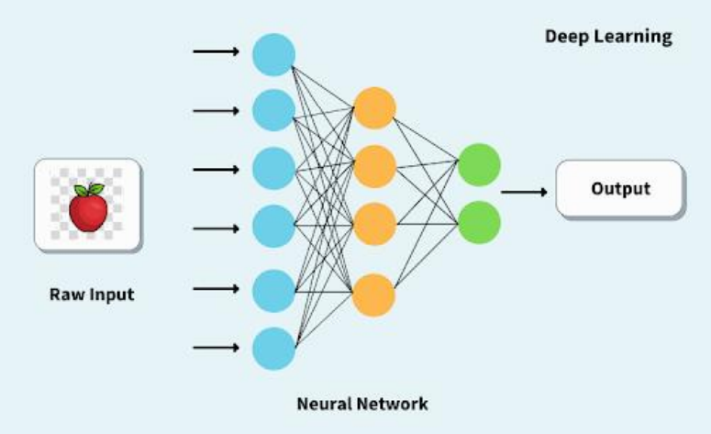

Slide 6
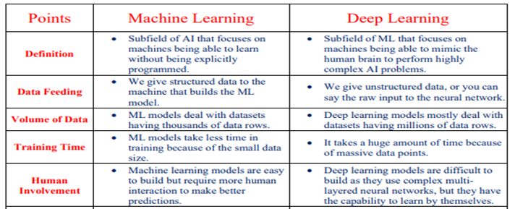

Slide 7
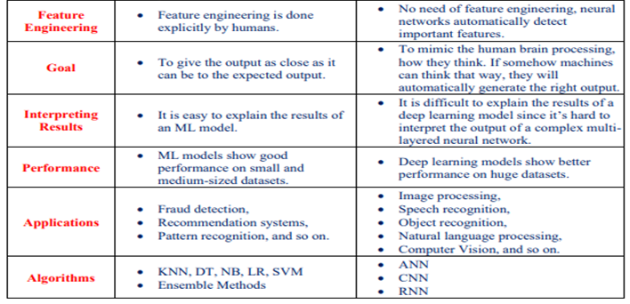

Slide 8

Applications of Deep Learning

Slide 9


Slide 10


Slide 11


Slide 12


Slide 13


Slide 14



Slide 15



Slide 16


Slide 17
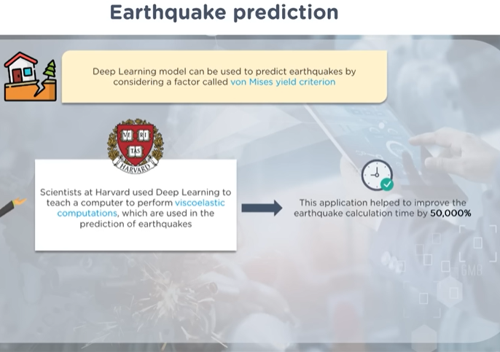

Slide 18
Fundamentals
Weights and Biases: The knowledge of a neural network is stored in the weights and biases that are learnt during the training process. These weights determine the influence that a given input (or neuron) has on an output.
Forward Propagation: Forward propagation is the process in which the neural network makes its predictions. Starting from the input layer, it propagates the input through the network, layer by layer, until it reaches the output layer. At each neuron, it multiplies the input by the weights, adds the bias, and applies the activation function to generate the output.
Activation Function: The activation function decides whether a neuron should be activated or not by transforming the weighted sum of the inputs and the bias. Common activation functions include theSigmoid, Tanh, and ReLU.

Slide 19
Fundamentals
Loss Function: A loss function measures the difference between the predicted output of the neural network and the actual output during training. The goal is to minimize this difference.
Optimizer: An optimizer is an algorithm used to adjust the parameters of your neural network, such as weights and learning rate, to reduce losses.
Backpropagation: This is a method used to calculate the gradient of the loss function with respect to each weight in the neural network, which in turn is used to update the weights and reduce the loss.

Slide 20
Fundamentals
Overfitting: Overfitting occurs when a model learns the training data too well, including its noise and outliers, and performs poorly on unseen data.
Underfitting: Underfitting is the opposite, where the model fails to learn the underlying patterns of the data.
Regularization: Techniques like dropout, weight decay, early stopping, are used to prevent overfitting by adding a penalty to the loss function or by altering the architecture of the neural network.

Slide 21
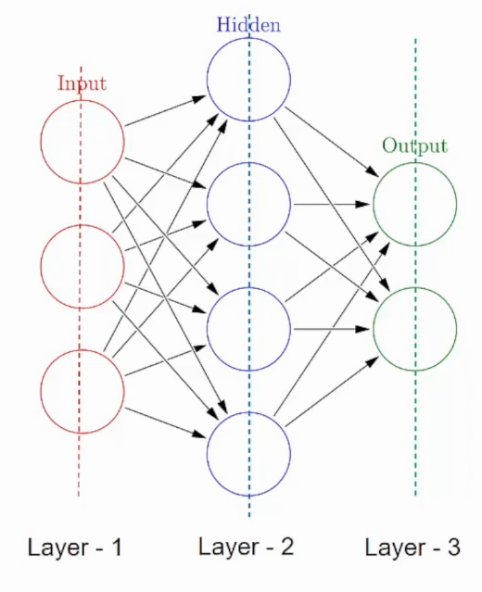
Building Blocks of a Neural Network
There are two building blocks of a Neural Network: Layers and Neurons
A neural network is made up of vertically stacked components called Layers.
There are three types of layers in a NN-

Slide 22
Building Blocks of a Neural Network
Input Layer– First is the input layer. This layer will accept the data and pass it to the rest of the network.
Hidden Layer– The second type of layer is called the hidden layer. Hidden layers are either one or more in number for a neural network. In the above case, the number is 1. Hidden layers are the ones that are actually responsible for the excellent performance and complexity of neural networks. They perform multiple functions at the same time such as data transformation, automatic feature creation, etc.
Output layer– The last type of layer is the output layer. The output layer holds the result or the output of the problem.

Slide 23
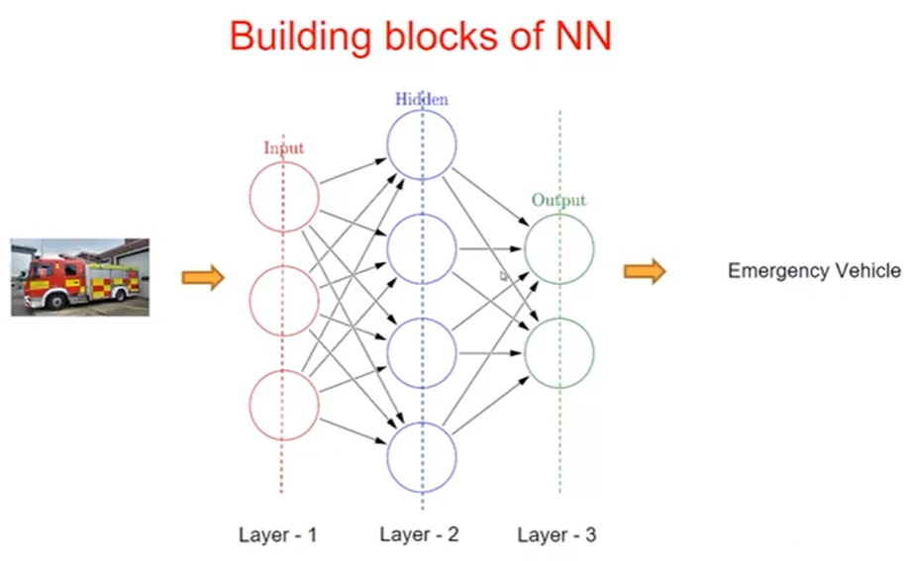

Slide 24
Building Blocks of a Neural Network
A layer consists of small individual units called neurons.
An artificial neuron is similar to a biological neuron. It receives input from the other neurons, performs some processing, and produces an output.
Most simple neural network is the “perceptron”, which consists of a single neuron.
In biological neurons, the neuron receives electrical signals from its Dendrites, modulate the electrical signals in various amounts, then fires an output signal through its Synapses only when the total strength of the input signals exceed a certain threshold. The output is then fed to another neuron and so forth.

Slide 25
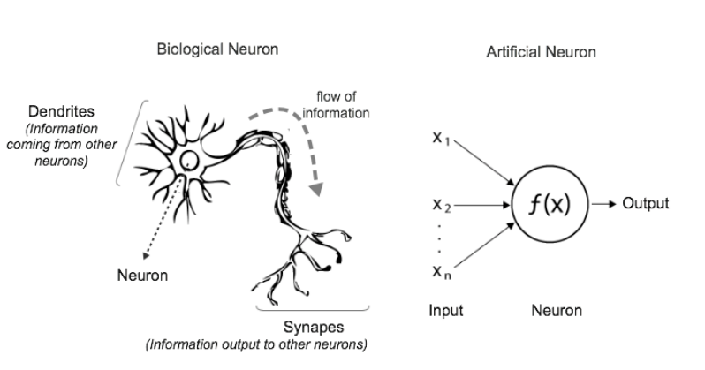
Perceptron

Slide 26
To model the biological neuron phenomenon, the artificial neuron performs two consecutive functions:
1) calculates the weighted sum of the inputs to represent the total strength of the input signals and
2) applies a step function to the result to determine whether to fire an output 1 if the signal exceeds a certain threshold or 0 if the signal doesn’t exceed the threshold.

Slide 27
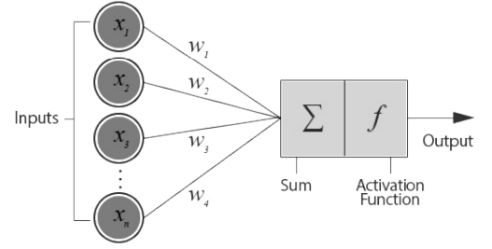
Not all input features are equally important (or useful features). Each input feature (xi) is assigned its own weight (wi) that reflects its importance in the decision making process.

Slide 28
In the perceptron diagram above, you can see the following:
1. Input vector
2. Weights vector
3. Neuron functions
4. Output

Slide 29
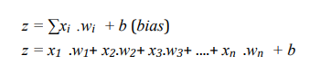
The calculations that happen inside the neuron: 1) weighted sum and 2) step function.
Weighted sum Function: Also known as linear combination. It is the sum of all inputs multiplied by their weights then added to a bias term.
This function produces a straight line represented in the following equation:

Slide 30
Step Activation Function: The activation function takes the same weighted sum input from before, z =∑x_{i}.w_{i} + b , and activates (fires) the neuron if the weighted sum is higher than a certain threshold.
The simplest activation function used by the perceptron algorithm is the “step function” that produces a binary output (0 or 1). It basically says that, if the summed input ≥ 0, then it "fires" (output = 1). Else (summed input < 0) it doesn't fire (output = 0).

Slide 31
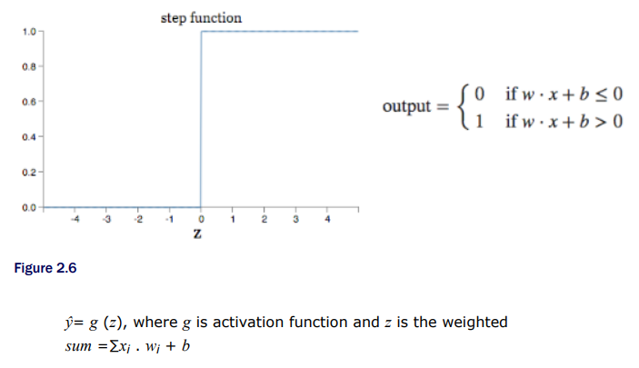

Slide 32
How does the perceptron learn?

Slide 33
How does the perceptron learn?
The neuron uses trial and error to learn from its mistakes. The perceptron’s learning logic goes like this:
1. The neuron calculates the weighted sum and apply the activation function to make a prediction ŷ. This is called feedforward process.
ŷ = activation (∑xi . wi + b)
2. It then compares the prediction with the actual to calculate the error
error =y -ŷ
3. Update the weight: if the prediction is too high, it will adjust the weights to make a lower prediction next time and vice versa.
4. Repeat!

Slide 34
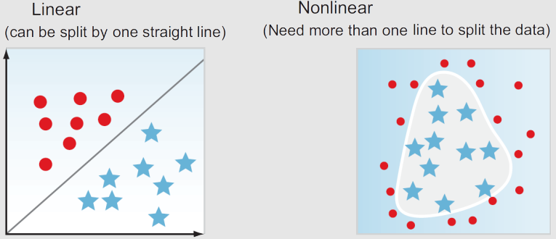
Is one neuron enough to solve complex problems?
No. The perceptron is a linear function. It works great with simple datasets that can be separated by a linear line.

Slide 35
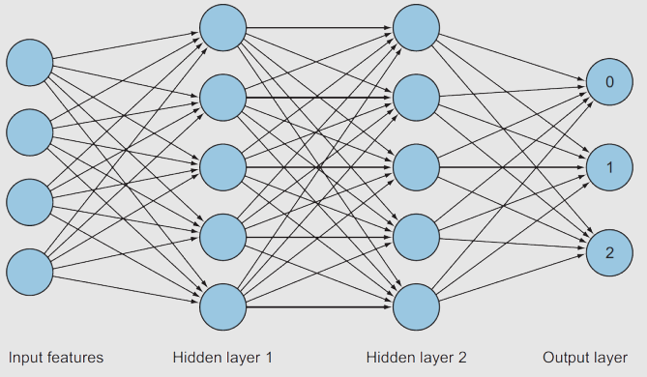
Multi-Layer Perceptron Architecture
A common neural network architecture is to stack the neurons in layers on top of each other called hidden layers. Each layer has n number of neurons. Layers are connected to each other by weights connections. This leads to the Multi-Layer Perceptron (MLP) architecture

Slide 36
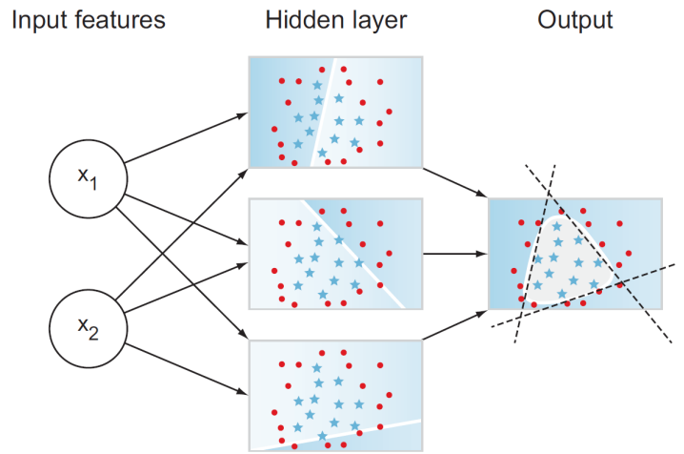
Multi-Layer Perceptron

Slide 37
The learning process is a repetition of three main steps:
Feedforward calculations to produce a prediction (weighted sum and activation),
Calculate the error, and
Backpropagate the error and update the weights to minimize the error

Slide 38
Feedforward/Forward Pass
The process of computing the linear combination and applying activation function is called Feedforward.
This process happens through the implementation of two consecutive functions:
1) the weighted sum, and
2) the activation function.
In short, the forward pass is the calculations through the layers to make a prediction

Slide 39
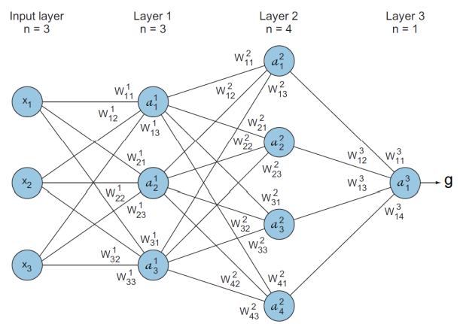
Let’s take a look at this simple three-layer neural network and explore each of its components:

Slide 40
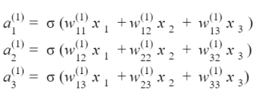
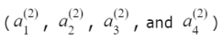
Feedforward calculations
Calculations at layer1 ,
Calculations at layer2 ,
Output prediction in layer 3:

Slide 41
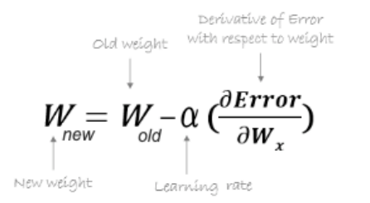
Backward Pass/Backpropagation
Backpropagation or backward pass is propagating derivatives of the error, with respect to each specific weight dE/dw_{i} from the last layer (output) back to the first layer (inputs) to adjust weights.

Slide 42
Neural Networks and Activation Function
Three important steps in a single iteration of deep neural architectures: Forward Propagation, Backward Propagation, and Gradient Descent(Optimization).
Forward Propagation: input data is fed in the forward direction through each layer of the neural network. The linear calculation takes place in this step and the activation function is applied.
Back Propagation: calculation of all the derivatives which will be further used for Optimization or updating the parameters.
Optimization: This step helps in the convergence of the loss function by continuously updating the parameters in each iteration. Some optimization algorithms are as follows: Gradient Descent, Momentum, Adam, AdaGrad, RMSProp, etc.

Slide 43
Activation Functions

Slide 44
What is an Activation Function?
An Activation Function decides whether a neuron should be activated or not i.e., it decides whether the neuron’s input to the network is important or n ot in the process of prediction using simple mathematical operations
It is also referred to as Transfer Function
The purpose of an activation function is to add non-linearity to the neural network
The Activation Functions can be basically divided into 3 types
Binary Step Function
Linear Activation Function
Non-linear Activation Functions

Slide 45
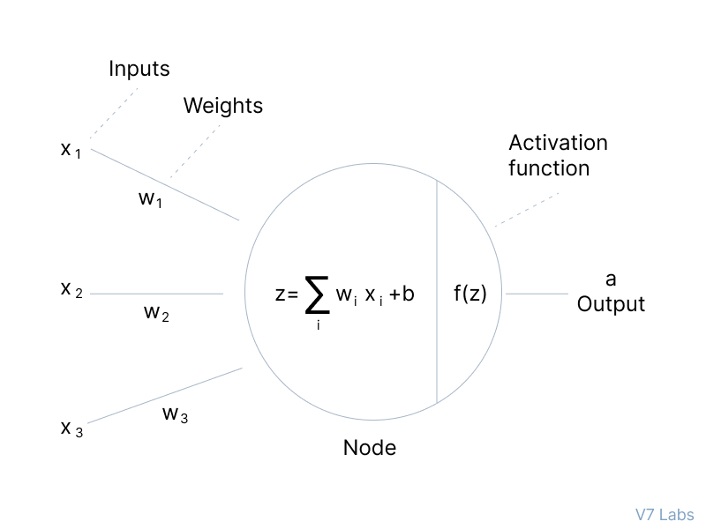
The primary role of the Activation Function is to transform the summed weighted input from the node into an output value to be fed to the next hidden layer or as output.

Slide 46
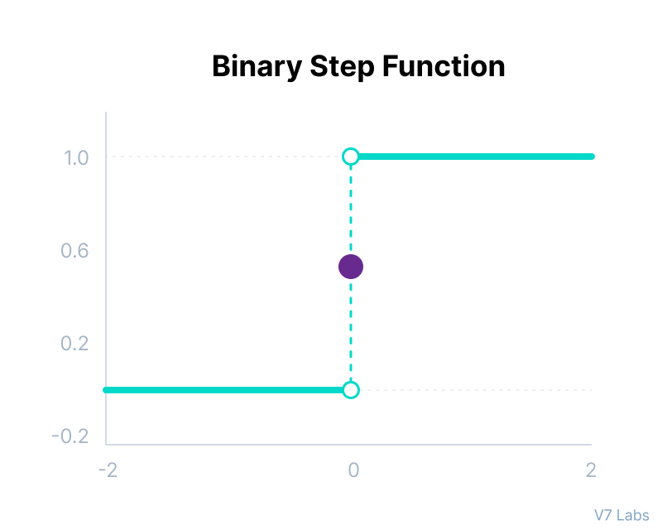
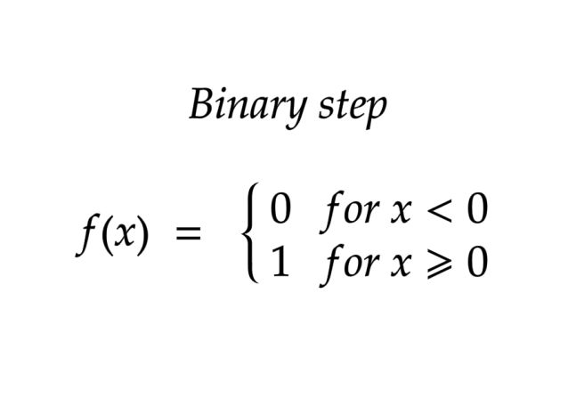
Binary Step Function
Binary step function depends on a threshold value that decides whether a neuron should be activated or not.
The input fed to the activation function is compared to a certain threshold; if the input is greater than it, then the neuron is activated, else it is deactivated, meaning that its output is not passed on to the next hidden layer.

Slide 47
Binary Step Function Cont..
Here are some of the limitations of binary step function:
It cannot provide multi-value outputs -for example, it cannot be used for multi-class classification problems.
The gradient of the step function is zero, which causes a hindrance in the backpropagation process.

Slide 48
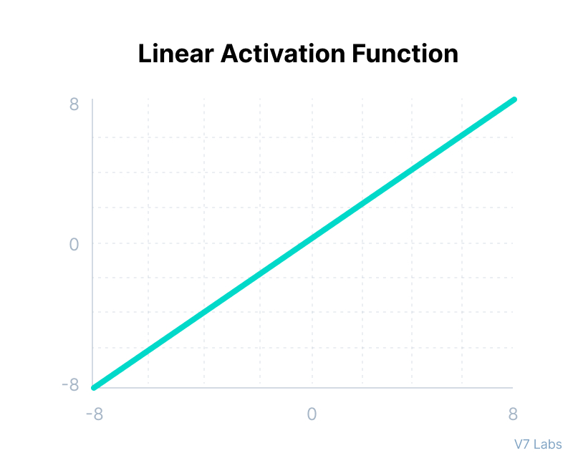
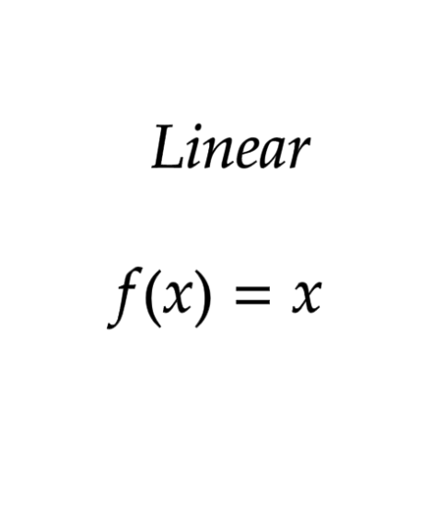
Linear Activation Function
The linear activation function, also known as "no activation," or “identity function”, is where the activation is proportional to the input.
The function doesn't do anything to the weighted sum of the input, it simply spits out the value it was given.

Slide 49
Linear Activation Function Cont..
A linear activation function has two major problems :
It’s not possible to use backpropagation as the derivative of the function is a constant and has no relation to the input x.
All layers of the neural network will collapse into one if a linear activation function is used. No matter the number of layers in the neural network, the last layer will still be a linear function of the first layer. So, essentially, a linear activation function turns the neural network into just one layer.

Slide 50
Non-Linear Activation Functions

Slide 51
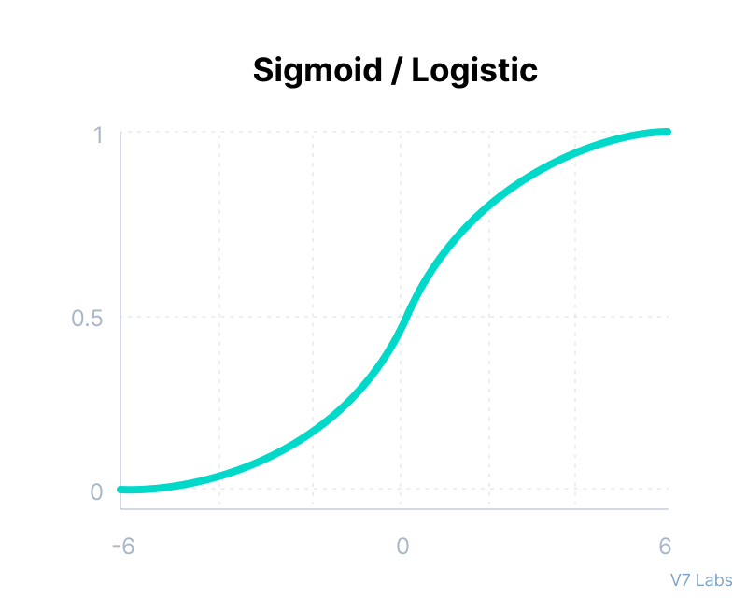
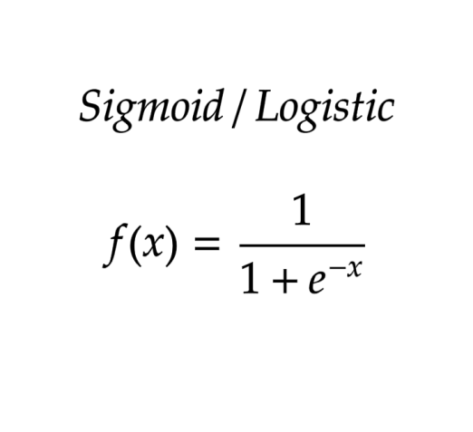
Sigmoid / Logistic Activation Function
This function takes any real value as input and outputs values in the range of 0 to 1.
The larger the input (more positive), the closer the output value will be to 1.0, whereas the smaller the input (more negative), the closer the output will be to 0.0, as shown below.

Slide 52
Sigmoid / Logistic Activation Function
Here’s why sigmoid/logistic activation function is one of the most widely used functions:
It is commonly used for models where we have to predict the probability as an output.
The function is differentiable and provides a smooth gradient, i.e., preventing jumps in output values. This is represented by an S-shape of the sigmoid activation function.
The limitations of sigmoid function are :
The derivative of the function is f'(x) = sigmoid(x)*(1-sigmoid(x))

Slide 53
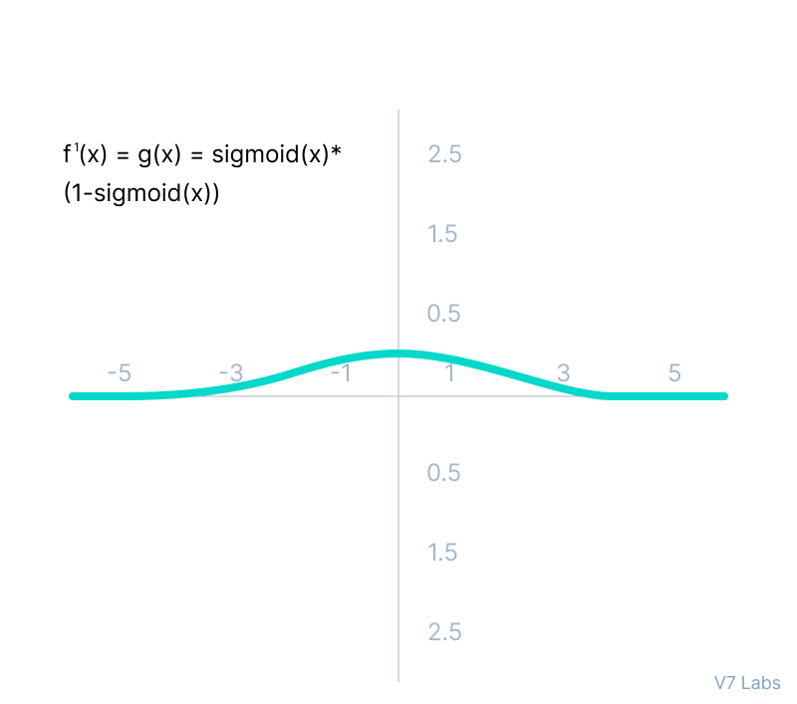
Sigmoid / Logistic Activation Function
From the Figure, the gradient values are only significant for range -3 to 3, and the graph gets much flatter in other regions.
It implies that for values greater than 3 or less than -3, the function will have very small gradients. As the gradient value approaches zero, the network ceases to learn and suffers from the Vanishing gradient problem.

Slide 54
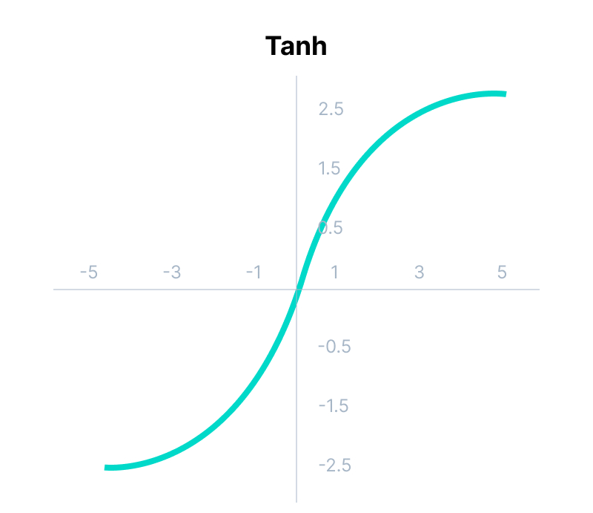
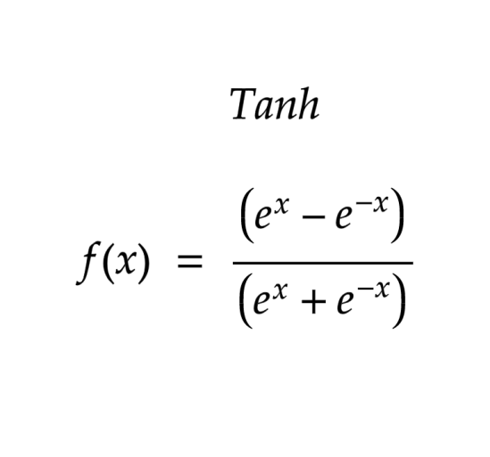
Tanh Function (Hyperbolic Tangent)
Tanh function is similar to the sigmoid activation function, and even has the same S-shape with the difference in output range of -1 to 1.
In Tanh, the larger the input (more positive), the closer the output value will be to 1.0, whereas the smaller the input (more negative), the closer the output will be to -1.0.

Slide 55
Tanh Function (Hyperbolic Tangent)
Advantages of using Tanh activation function are:
The output of the tanh activation function is Zero centered; hence we can easily map the output values as strongly negative, neutral, or strongly positive.
Usually used in hidden layers of a neural network as its values lie between -1 to +1; therefore, the mean for the hidden layer comes out to be 0 or very close to it. It helps in centering the data and makes learning for the next layer much easier.

Slide 56
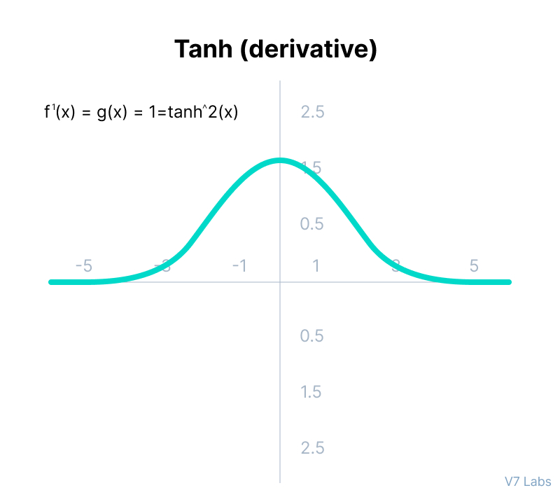
Tanh Function (Hyperbolic Tangent)
It also faces the problem of vanishing gradients similar to the sigmoid activation function. Plus the gradient of the tanh function is much steeper as compared to the sigmoid function.

Slide 57
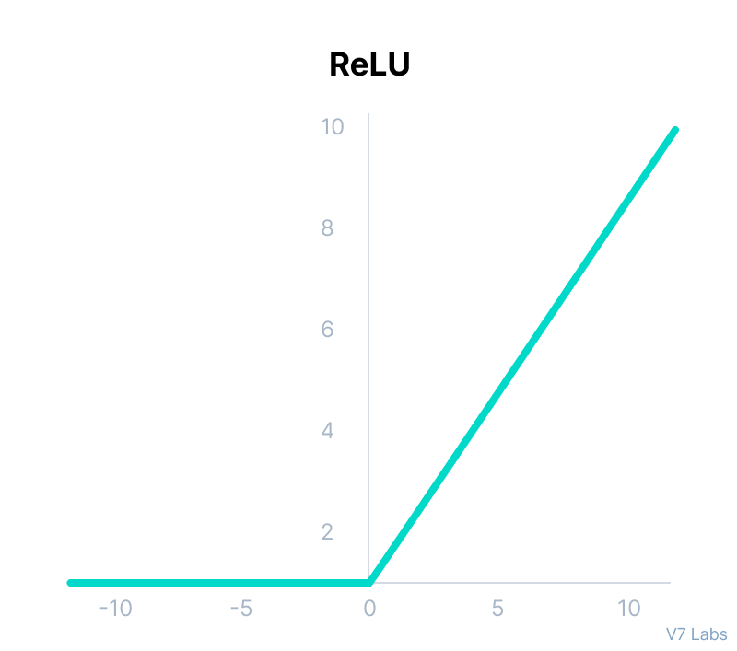
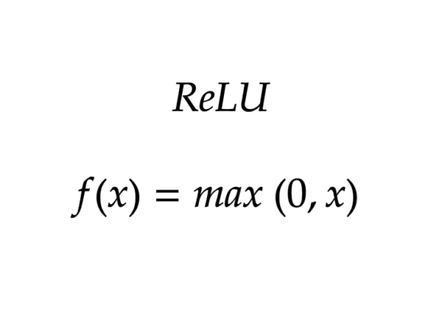
ReLU Activation Function
ReLU stands for Rectified Linear Unit.
ReLU has a derivative function that allows backpropagation while simultaneously making it computationally efficient.
The neurons will only be deactivated if the output of the linear transformation is less than 0.

Slide 58
ReLU Activation Function
Advantages ReLU activation function are as follows:
Since only a certain number of neurons are activated, the ReLU function is far more computationally efficient when compared to the sigmoid and tanh functions.
ReLU accelerates the convergence of gradient descent towards the global minimum of the loss function due to its linear, non-saturating property.

Slide 59
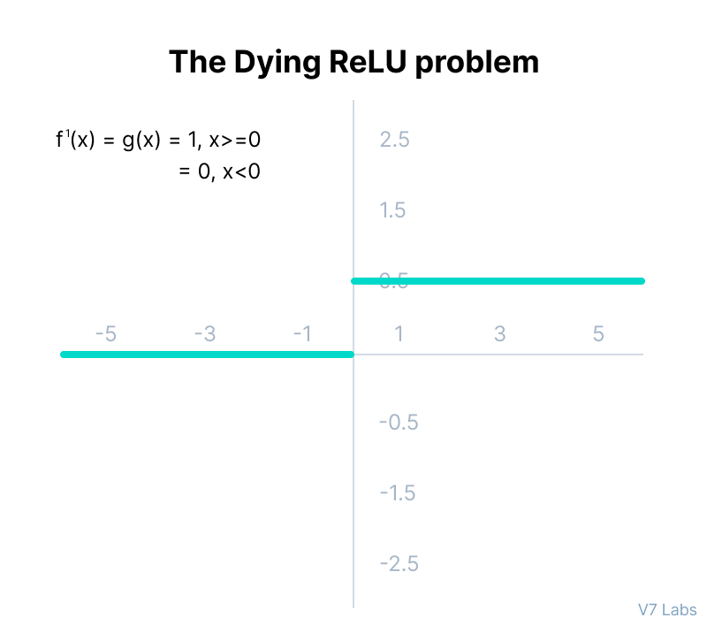
ReLU Activation Function
The negative side of the graph makes the gradient value zero. Due to this reason, during the backpropagation process, the weights and biases for some neurons are not updated. This can create dead neurons which never get activated.
All the negative input values become zero immediately, which decreases the model’s ability to fit or train from the data properly.

Slide 60
ReLU Activation Function
A dying ReLU always outputs the same value, i.e., 0, on any input value. This condition is known as the dead state of ReLU neurons. In this state, it is difficult to recover because the gradient of 0 is 0. This becomes a problem when most of the input ranges are negative, or the derivative of the ReLU function is 0.

Slide 61
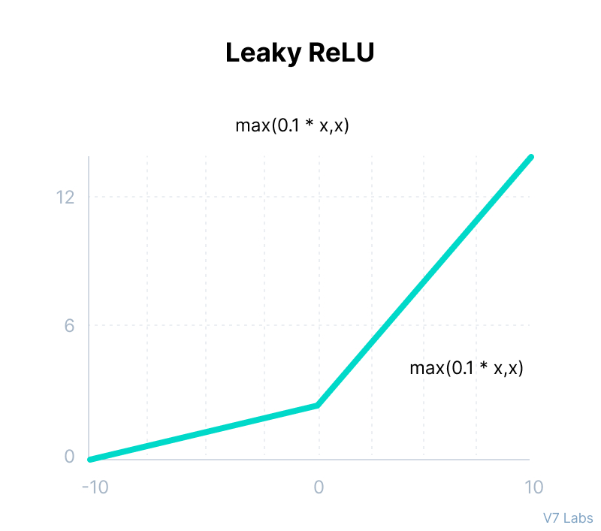
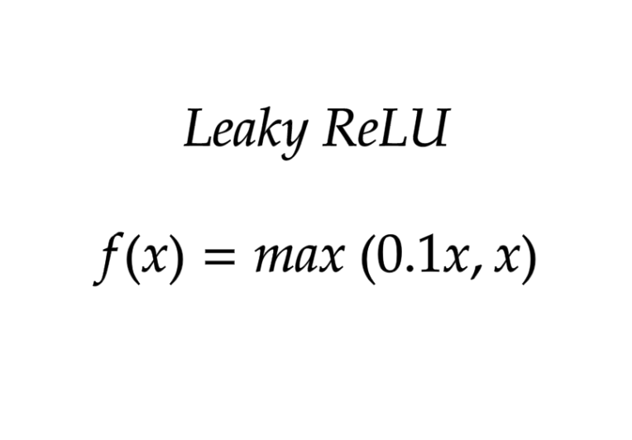
Leaky ReLU Function
Leaky ReLU is an improved version of ReLU function to solve the Dying ReLU problem as it has a small positive slope in the negative area.

Slide 62
Leaky ReLU Activation Function
The advantages of Leaky ReLU are same as that of ReLU, in addition to the fact that it does enable backpropagation, even for negative input values.
By making this minor modification for negative input values, the gradient of the left side of the graph comes out to be a non-zero value. Therefore, we would no longer encounter dead neurons in that region.

Slide 63
Leaky ReLU Activation Function
The limitations that this function faces include:
The predictions may not be consistent for negative input values.
The gradient for negative values is a small value that makes the learning of model parameters time-consuming.

Slide 64
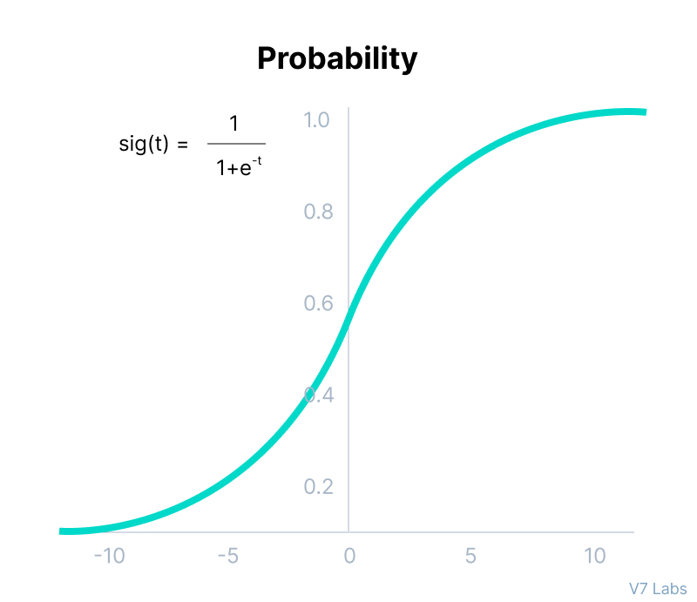
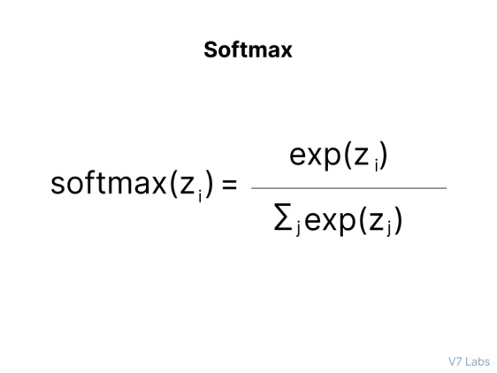
Softmax Function
Used when trying to handle multiple classes. The softmax function would squeeze the outputs for each class between 0 and 1 and would also divide by the sum of the outputs.

Slide 65
Activation for Hidden Layers
There are perhaps three activation functions you may want to consider for use in hidden layers; they are:
Rectified Linear Activation (ReLU)
Logistic (Sigmoid)
Hyperbolic Tangent (Tanh)
This is not an exhaustive list of activation functions used for hidden layers, but they are the most commonly used.

Slide 66
Activation for Output Layers
We have activation function depending on whether the node in hidden layer / output layer depending on what type of problem we are dealing.:
Activation function for your output layer:
Regression - Linear Activation Function
Binary Classification—Sigmoid/Logistic Activation Function
Multiclass Classification—Softmax

Slide 67
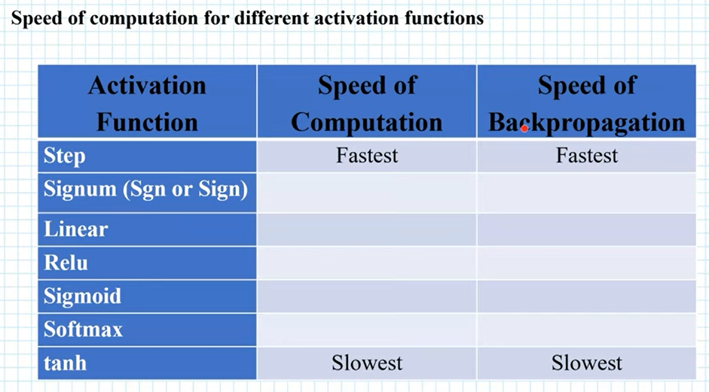

Slide 68
Vanishing gradient &Exploding gradient
In a network of n hidden layers, n derivatives will be multiplied together. If the derivatives are large then the gradient will increase exponentially as we propagate down the model until they eventually explode, and this is what we call the problem of exploding gradient.
Alternatively, if the derivatives are small then the gradient will decrease exponentially as we propagate through the model until it eventually vanishes, and this is the vanishing gradient problem.

Slide 69
Exploding Gradient | Vanishing Gradient
There is an exponential growth in the model parameters. | The parameters of the higher layers change significantly whereas the parameters of lower layers would not change much (or not at all).
The model weights may become NaN during training. | The model weights may become 0 during training.
The model weights may become NaN during training. | The model learns very slowly and perhaps the training stagnates at a very early stage just after a few iterations.

Slide 70
What Is Convergence In Neural Network
Convergence in neural networks is a process of adjusting the weights and biases to improve the accuracy of a model.
The goal of convergence is to find the optimal weights and biases that will minimize the error rate of the model.
Convergence is an important part of training a neural network and is essential for achieving the best possible accuracy.
Notes:
Convergence- the fact that two or more things, ideas, etc. become similar or come together

Slide 71
How Does Convergence Work?
Convergence is done by using an optimization algorithm such as gradient descent.
The algorithm works by calculating the error rate of the model and then adjusting the weights and biases accordingly.
This process is repeated until the error rate is minimized and the model is optimized.

Slide 72
Why does a neural net fail to converge?
Implementation of not enough nodes may be a reason behind this issue because models with fewer nodes need to change their architecture drastically to model the data better and fail to converge.
The amount of the training data is low or the data we are pushing on the model is corrupted or not collected with the data integrity.
The activation function we are using with the network often leads to good results from the model but if complexity is higher then the model can fail to converge.

Slide 73
Why does a neural net fail to converge?
Inappropriate weight application in the network can also cause a failure in convergence. The weights we are applying to the network should be well calculated according to the activation function.
The learning rate parameter we have given in the network should be moderate which means it should not be much larger or much lower.

Slide 74
Difficulties in Convergence
It can be difficult to find the optimal weights and biases for a model. This is because the optimization process is complex and requires a lot of trial and error.
The optimization process can be time-consuming and can require a lot of computing power.
The optimization process can be prone to errors, which can lead to inaccurate results.

Slide 75
How To Improve Convergence?
There are several ways to improve the convergence process.
One way is to use a more sophisticated optimization algorithm such as Adam or RMSProp. These algorithms are more efficient and can help to reduce the amount of time needed to optimize a model.
It is important to use a large enough dataset to ensure that the model is properly trained.
Finally, it is important to use regularization techniques such as dropout or batch normalization to reduce the risk of overfitting.

Slide 76
Remedies for convergence failure
Implementing momentum: sometimes convergence depends on the data and if the data is making a model producing errors like a hair comb. The implementation of neural network momentum can help in avoiding convergence and also helps in boosting the accuracy and speed of the model.
Reinitialization of the weights of the network can help in avoiding the failure of convergence.
If the training is stuck in the local minima and subsequent sessions have exceeded max iteration, this means the session has failed and we will get a higher error. In such a situation starting another session can be helpful.

Slide 77
Remedies for convergence failure
Change in the activation function can be helpful. For example, we are using a ReLU activation and the neurons of the nodes become biased and this can cause the neuron to never be activated. In such a situation changing the activation function to another activation can be helpful.
While performing classification using neural networks, then we can use the shuffling of the training data to avoid the failure in convergence.
The learning rate and the number of epochs should be proportional while modelling a network. Applying a lower number of epochs causes the convergence to happen in smaller steps and a bigger number of epochs there will mean a long wait in the appearance of the convergence. A higher learning rate or the number of epochs should be avoided to make the neural network converge faster.

Slide 78
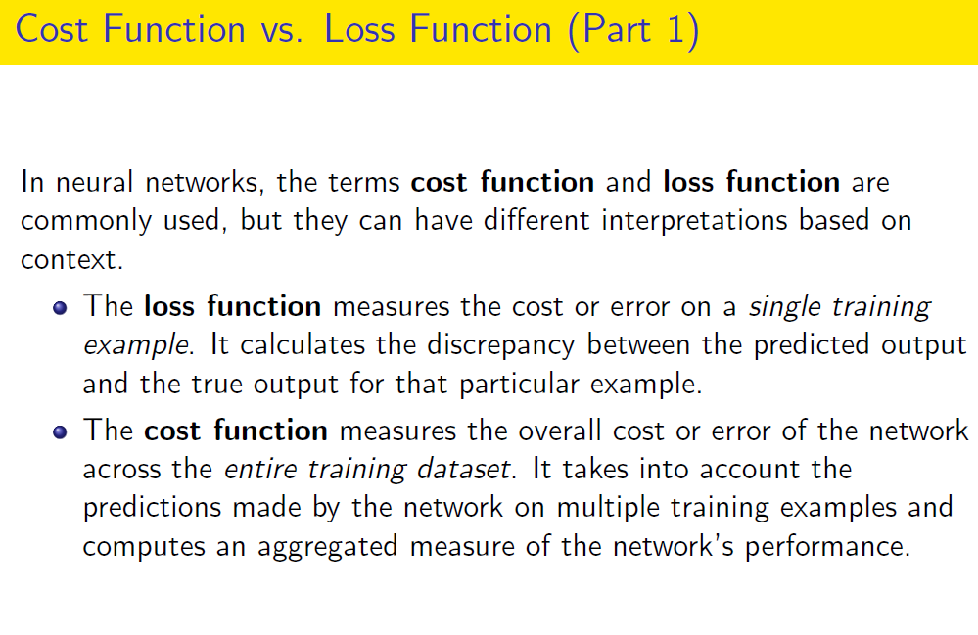

Slide 79
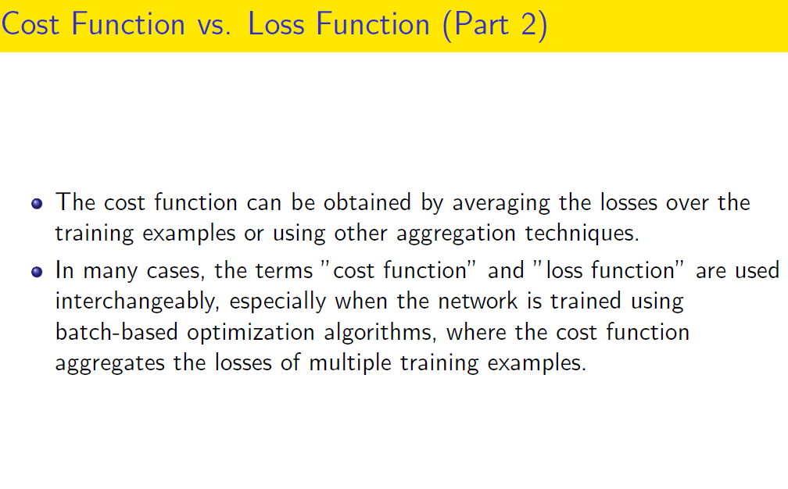

Slide 80
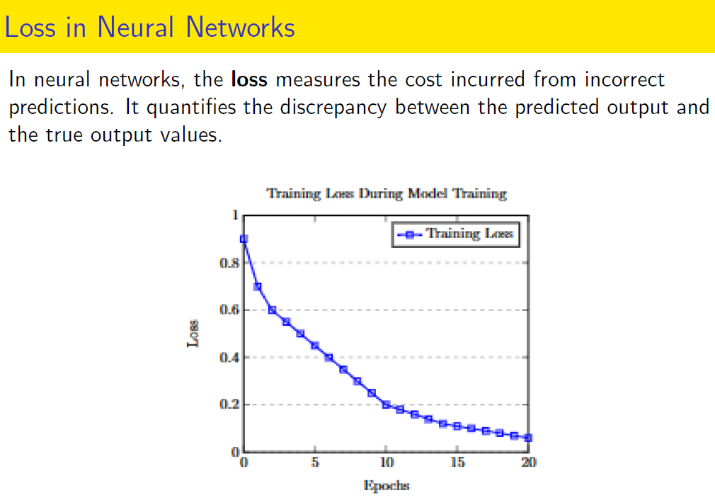

Slide 81
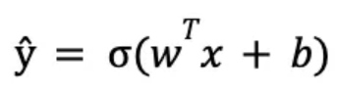
Loss Functions
Loss functions are one of the most important aspects of neural networks, as they are directly responsible for fitting the model to the given training data.
A neural network processes the input data at each layer and eventually produces a predicted output value.
Each training input is loaded into the neural network in a process called forward propagation. Once the model has produced an output, this predicted output is compared against the given target output in a process called backpropagation — the weights and biases of the model are then adjusted so that it now outputs a result closer to the target output.

Slide 82
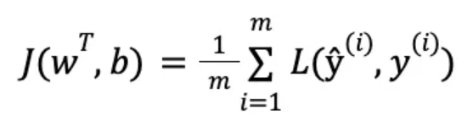
Loss Functions
A loss function is a function that compares the target and predicted output values; measures how well the neural network models the training data.
The hyperparameters are adjusted to minimize the average loss — we find the weights, w^{T}, and biases, b, that minimize the value of J (average loss).
which measure the distance of the actual y values from the regression line (predicted values) — the goal being to minimize the net distance.

Slide 83
Types of Loss Functions
There are two main types of loss functions
Regression Loss Functions - used in regression neural networks;
Ex. Mean Squared Error, Mean Absolute Error
Classification Loss Functions - used in classification neural networks;
Ex. Binary Cross-Entropy, Categorical Cross-Entropy

Slide 84
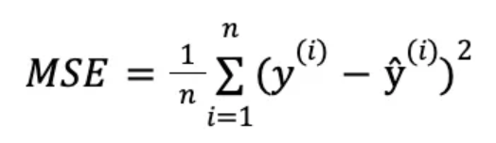
Types of Loss Functions
Mean Squared Error (MSE): One of the most popular loss functions, MSE finds the average of the squared differences between the target and the predicted outputs
One disadvantage of this loss function is that it is very sensitive to outliers; if a predicted value is significantly greater than or less than its target value, this will significantly increase the loss.

Slide 85
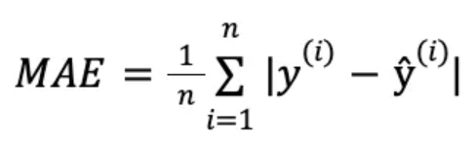
Types of Loss Functions
Mean Absolute Error (MAE): MAE finds the average of the absolute differences between the target and the predicted outputs.
This loss function is used as an alternative to MSE. As mentioned previously, MSE is highly sensitive to outliers, which can dramatically affect the loss because the distance is squared. MAE is used in cases when the training data has a large number of outliers to mitigate
It also has some disadvantages; as the average distance approaches 0, gradient descent optimization will not work, as the function's derivative at 0 is undefined (which will result in an error, as it is impossible to divide by 0).

Slide 86
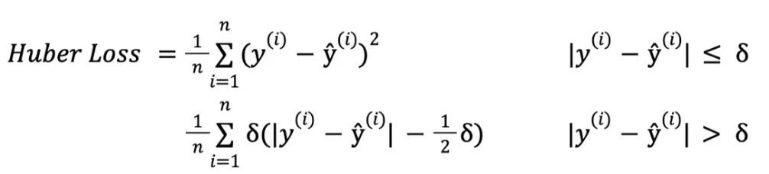
Types of Loss Functions
A loss function called a Huber Loss was developed, which has the advantages of both MSE and MAE.
If the absolute difference between the actual and predicted value is less than or equal to a threshold value, 𝛿, then MSE is applied. Otherwise, if the error is sufficiently large MAE is applied.

Slide 87
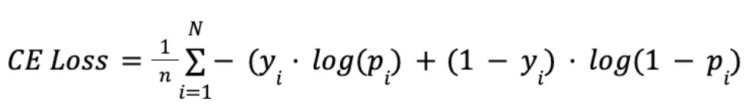
Types of Loss Functions
Binary Cross-Entropy/Log Loss
This is the loss function used in binary classification models - where the model takes in an input and has to classify it into one of two pre-set categories.
In binary classification, there are only two possible actual values of y — 0 or 1. Thus, to accurately determine loss between the actual and predicted values, it needs to compare the actual value (0 or 1) with the probability that the input aligns with that category (p(i) = probability that the category is 1; 1 — p(i) = probability that the category is 0)

Slide 88
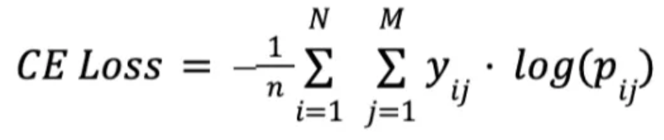
Types of Loss Functions
Categorical Cross-Entropy Loss
In cases where the number of classes is greater than two, we utilize categorical cross-entropy — this follows a very similar process to binary cross-entropy.
Binary cross-entropy is a special case of categorical cross-entropy, where M = 2 - the number of categories is 2.

Slide 89
Optimizers
Optimizer algorithms are optimization method that helps improve a deep learning model’s performance.
Optimizers are algorithms used to find the optimal set of parameters for a model during the training process.
These algorithms adjust the weights and biases in the model iteratively until they converge on a minimum loss value.
These optimization algorithms or optimizers widely affect the accuracy and speed training of the deep learning model.

Slide 90
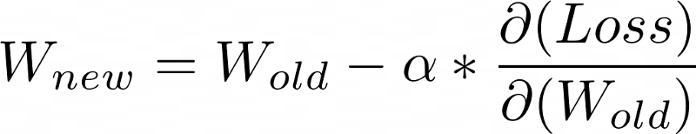
Gradient Descent
Gradient Descent is the most basic optimization algorithm. It’s used in linear regression and classification algorithms.
It uses whole dataset for training the model at once for each epoch and update the weights
It directly uses the derivative of the loss function and learning rate to reduce the loss and achieve the minima.
The weights are updated when the whole dataset gradient is calculated, which slows down the process. It also requires a large amount of memory to store this temporary data, making it a resource-hungry process.

Slide 91

Gradient Descent
Advantages
Simple to implement.
Can work well with a well-tuned learning rate.
Disadvantages
As the method calculates the gradient for the entire data set in one update, the calculation is very slow.
It requires large memory and it is computationally expensive.

Slide 92

Stochastic Gradient Decent
This is a variation of the GD, where the model parameters are updated on every iteration. It means that after every training sample, the loss function is tested and the model is updated.
If the model has 10K dataset SGD will update the model parameters 10k times.
Stochastic Gradient Descent

Slide 93
Stochastic Gradient Decent
These frequent updates result in converging to the minima in less time, but it comes at the cost of increased variance that can make the model overshoot the required position.
Advantages:
It can be faster than standard gradient descent, especially for large datasets.
Can escape local minima more easily.
Disadvantages:
It can be noisy, leading to less stability.
It may require more hyperparameter tuning to get good performance.

Slide 94

Mini-Batch Gradient Descent
Mini-batch gradient descent is similar to SGD, but instead of using a single sample to compute the gradient, it uses a small, fixed-size "mini-batch" of samples. The update rule is the same as for SGD, except that the gradient is averaged over the mini-batch. This can reduce noise in the updates and improve convergence.

Slide 95
Mini-Batch Gradient Descent
Advantages:
It can be faster than standard gradient descent, especially for large datasets.
Can escape local minima more easily.
Can reduce noise in updates, leading to more stable convergence.
Disadvantages:
Can be sensitive to the choice of mini-batch size.

Slide 96
Drawbacks of base optimizers: (GD, SGD, mini-batch GD)
Gradient Descent uses the whole training data to update weight and bias. Suppose if we have millions of records then training becomes slow and computationally very expensive.
SGD solved the Gradient Descent problem by using only single records to updates parameters. But, still, SGD is slow to converge because it needs forward and backward propagation for every record. And the path to reach global minima becomes very noisy.
Mini-batch GD overcomes the SGD drawbacks by using a batch of records to update the parameter. Since it doesn't use entire records to update parameter, the path to reach global minima is not as smooth as Gradient Descent.

Slide 97

The above figure is the plot between the number of epoch on the x-axis and the loss on the y-axis. We can clearly see that in Gradient Descent the loss is reduced smoothly whereas in SGD there is a high oscillation in loss value.

Slide 98

SGD with momentum
SGD with momentum is a variant of SGD that adds a "momentum" term to the update rule, which helps the optimizer to continue moving in the same direction even if the local gradient is small. The momentum term is typically set to a value between 0 and 1.
The momentum is calculated using the following formula

Slide 99

SGD with momentum
In this algorithm, we use Exponentially Weighted Averages to compute Gradient and used this Gradient to update parameter.
An equation to update weights and bias in SGD with momentum

Slide 100

SGD with momentum
In SGD with momentum, we have added momentum in a gradient function. By this I mean the present Gradient is dependent on its previous Gradient and so on. This accelerates SGD to converge faster and reduce the oscillation.
The above images shows how the convergence happens in SGD with momentum vs SGD without momentum.

Slide 101
SGD with momentum
Advantages of SGD with momentum
Momentum helps to reduce the noise.
It can help to reduce oscillations and improve convergence.
Disadvantage of SGD with momentum
Requires tuning of the momentum hyperparameter.
Can overshoot good solutions and settle for suboptimal ones if the momentum is too high.

Slide 102
Adagrad (Adaptive Gradient Descent)
Adagrad is an optimization algorithm that uses an adaptive learning rate per parameter.
The learning rate is updated based on the historical gradient information so that parameters that receive many updates have a lower learning rate, and parameters that receive fewer updates have a larger learning rate.

Slide 103

Adagrad (Adaptive Gradient Descent)
The Adagrad algorithm uses the below formulas..
In the above Adagrad optimizer equation, the learning rate has been modified in such a way that it will automatically decrease because the summation of the previous gradient square will always keep on increasing after every time step.

Slide 104
Adagrad (Adaptive Gradient Descent)
Advantages:
It can work well with sparse data.
Automatically adjusts learning rates based on parameter updates.
Disadvantages:
Can converge too slowly for some problems.
Can stop learning altogether if the learning rates become too small.

Slide 105
Adadelta
It is an extension of AdaGrad which tends to remove the decaying learning Rate problem of it.
It uses an exponentially decaying average of the gradients and the squares of the gradients. Instead of accumulating all previously squared gradients, Adadelta limits the window of accumulated past gradients to some fixed size w. For example, computing the squared gradient of the past 10 gradients and average out.
The formula for the new weight remains the same as in Adagrad

Slide 106

Adadelta
The Learning rate is calculated using the formula,
Thus because of the restricting term, the weighted average will increase at a slower rate, making the learning rate to reduce slowly to reach the global minima.

Slide 107
Adadelta
Advantages:
Can work well with sparse data.
Automatically adjusts learning rates based on parameter updates.
Disadvantages:
Can converge too slowly for some problems.
Can stop learning altogether if the learning rates become too small.

Slide 108
RMSprop (Root Mean Square Propagation)
RMS-Prop is a special version of Adagrad in which the learning rate is an exponential average of the gradients instead of the cumulative sum of squared gradients. This helps to reduce the monotonic learning rate decay of Adagrad and improve convergence

Slide 109
RMSprop (Root Mean Square Propagation)
Advantages:
It can work well with sparse data.
Automatically adjusts learning rates based on parameter updates.
Can converge faster than Adagrad.
Disadvantages:
It can still converge too slowly for some problems.
Requires tuning of the decay rate hyperparameter.

Slide 110
Adam (Adaptive Moment Estimation)
Adam optimizer is one of the most popular optimization algorithm.
It is a method that computes adaptive learning rates for each parameter. It stores both the decaying average of the past gradients , similar to momentum and also the decaying average of the past squared gradients , similar to RMS-Prop and Adadelta. Thus, it combines the advantages of both the methods.

Slide 111


Adam
Exponential Weighted Averages for past gradients
Exponential Weighted Averages for past squared gradients
Where β and γ are the initial restricting parameters for SGD with Momentum and Adadelta respectively.

Slide 112

Adam
Using the previous equation, now the weight and bias updation formula looks like:
Advantages:
Can converge faster than other optimization algorithms.
Can work well with noisy data.
Disadvantages:
It may require more tuning of hyperparameters than other algorithms.
May perform better on some types of problems.

Slide 113
Learning Rate Decay
While training neural networks with Stochastic or Mini Batch SGD and a constant learning rate our algorithm usually converges towards minima in a noisy manner ( less noisier in MBGD) and end up oscillating far away from actual minima , to overcome this scenario researchers bring up a proposal to decay the learning rate over time which helps the network converge to a local minimum and avoid oscillation.
Learning rate decay is a technique for training modern neural networks.
It starts training the network with a large learning rate and then slowly reducing/decaying it until local minima is obtained. It is empirically observed to help both optimization and generalization.

Slide 114


Learning Rate Decay

Slide 115
Learning Rate Decay
In the very first image where we have a constant learning rate, the steps taken by our algorithm while iterating towards minima are so noisy that after certain iterations it seems wandering around the minima and do not actually converges.
But in the second image where learning rate is reducing over time (represented with green line), since the learning rate is large initially we still have relatively fast learning but as tending towards minima learning rate gets smaller and smaller, end up oscillating in a tighter region around minima rather than wandering far away from it.

Slide 116
Learning Rate Decay
Learning rate decay (common method):
α=(1/(1+decayRate×epochNumber))*​α0
1 epoch : 1 pass through data
α : learning rate (current iteration)
α0 : Initial learning rate
decayRate : hyper-parameter for the method
Example: Suppose we have α0 = 0.2 and decay rate=1 , then for the each epoch we can examine the fall in learning rate α as:
Epoch 1: alpha 0.1
Epoch 2: alpha 0.067
Epoch 3: alpha 0.05
Epoch 4: alpha 0.04

Slide 117
Learning Rate Decay
Exponential Decay : The decayRate of this method is always less then 1 , 0.95 is most commonly used among practitioners.
α = ( decayRate^(epochNumber) )*α0
Epoch Number Based: In this method we take some constant ‘k’ and divide it with square root of epoch number.
α = ( k/ √epochNumber )* α0
Mini-batch Number based : In this method we take some constant ‘k’ and divide it with square root of Mini-Batch number. (This method is only used for Mini Batch Gradient Descent.)
α = ( k/ √t)* α0

Slide 118
Learning Rate Decay
Discrete Staircase :In this method learning rate is decreased in some discrete steps after every certain interval of time , for example you are reducing learning rate to its half after every 10 secs.
Manual Decay : In this method practitioners manually examine the performance of algorithm and decrease the learning rate manually day by day or hour by hour etc.

Slide 119
Weight Initialization
Its main objective is to prevent layer activation outputs from exploding or vanishing gradients during the forward propagation. If either of the problems occurs, loss gradients will either be too large or too small, and the network will take more time to converge
Training the network without a useful weight initialization can lead to a very slow convergence or an inability to converge
The most used weight initialization techniques are:
Zero Initialization (Initialized all weights to 0)
Random initialization

Slide 120
weight initialization
Zero Initialization (Initialized all weights to 0)
If we initialized all the weights with 0, then what happens is that the derivative wrt loss function is the same for every weight in W[l], thus all weights have the same value in subsequent iterations. This makes a model as a linear model.

Slide 121
weight initialization
Random initialization : Assigning random values to weights is better than just 0 assignment. But what happens if weights are initialized high values or very low values and what is a reasonable initialization of weight values.
If weights are initialized with very high values the term np.dot(W,X)+b becomes significantly higher and if an activation function like sigmoid() is applied, the function maps its value near to 1 where the slope of gradient changes slowly and learning takes a lot of time.

Slide 122
weight initialization
Random initialization :
If weights are initialized with low values it gets mapped to 0, where the case is the same as above. This problem is often referred to as the vanishing gradient.

Slide 123


Slide 124
Preprocessing
Data preprocessing refers to the cleaning, transforming, and integrating of data in order to make it ready for training.
The goal of data preprocessing is to improve the quality of the data and to make it more suitable for the specific task.
Some common steps in data preprocessing include:
Data Cleaning: This involves identifying and correcting errors or inconsistencies in the data, filling missing values, smoothing the noisy data, resolving the inconsistency, and removing outliers.

Slide 125

Data Cleaning

Slide 126
Preprocessing
Data Integration: This involves combining data from multiple sources to create a unified dataset. Data integration can be challenging as it requires handling data with different formats, structures, and semantics.
Some issues while adopting Data Integration
Schema integration and object matching: The data can be present in different formats, and attributes that might cause difficulty in data integration.
Removing redundant attributes from all data sources.
Detection and resolution of data value conflicts.

Slide 127
Preprocessing
Data Transformation: Once data clearing has been done, we need to consolidate the quality data into alternate forms by changing the value, structure, or format of data using the below-mentioned Data Transformation strategies.
Normalization: It is the most important Data Transformation technique widely used. The numerical attributes are scaled up or down to fit within a specified range. Normalization can be done in multiple ways, which are highlighted here:
Min-max normalization
Z-Score normalization
Decimal scaling normalization

Slide 128
Preprocessing
Data Transformation:
Attribute Selection: New properties of data are created from existing attributes to help in the data mining process. For example, date of birth, data attribute can be transformed to another property like is_senior_citizen for each tuple, which will directly influence predicting diseases or chances of survival, etc.
Aggregation: It is a method of storing and presenting data in a summary format. For example sales, data can be aggregated and transformed to show as per month and year format.

Slide 129
Preprocessing
Data Reduction: The size of the dataset can be too large to be handled. So, possible solution is to obtain a reduced representation of the dataset that is much smaller in volume but produces the same quality
Data Reduction strategies:
Data aggregation: It is a way of data reduction, in which the gathered data is expressed in a summary form.
Dimensionality reduction: These techniques are used to perform feature extraction. Dimensionality reduction can be done using techniques like Principal Component Analysis etc.
Data compression: By using encoding technologies, the size of the data can significantly reduce.

Slide 130
Preprocessing
Data Reduction:
Discretization: Data discretization is used to divide the attributes of the continuous nature into data with intervals. For example, attribute age can be discretized into bins like below 18, 18-44, 44-60, above 60
Attribute subset selection: It is very important to be specific in the selection of attributes. Otherwise, it might lead to high dimensional data, which are difficult to train due to underfitting/overfitting problems. Only attributes that add more value towards model training should be considered, and the rest all can be discarded.

Slide 131

Regularization
Regularization refers to a set of different techniques that lower the complexity of a neural network model during training, and thus prevent the overfitting.
There are three very popular and efficient regularization techniques called L1, L2, and dropout
Regularization is a technique which makes slight modifications to the learning algorithm such that the model generalizes better. This in turn improves the model’s performance on the unseen data as well.

Slide 132

Regularization:
Different Regularization Techniques in Deep Learning
L1 and L2 are the most common types of regularization. These update the general cost function by adding another term known as the regularization term.
Cost function = Loss (say, binary cross entropy) + Regularization term
Due to the addition of this regularization term, the values of weight matrices decrease because it assumes that a neural network with smaller weight matrices leads to simpler models. Therefore, it will also reduce overfitting to quite an extent.
In L2, we have:
lambda is the regularization parameter

Slide 133

Regularization:
L2 regularization is also known as weight decay as it forces the weights to decay towards zero (but not exactly zero).
In L1 regularization, we have:
In this, we penalize the absolute value of the weights. Unlike L2, the weights may be reduced to zero here. Hence, it is very useful when we are trying to compress our model. Otherwise, we usually prefer L2 over it.

Slide 134

Regularization:
Dropout
In addition to the L2 and L1 regularization, another famous and powerful regularization technique is called the dropout regularization.
In a nutshell, dropout means that during training with some probability P a neuron of the neural network gets turned off during training. Let’s look at a visual example.

Slide 135
Regularization:
Dropout: In figure
Assume on the left side we have a feedforward neural network with no dropout. Using dropout with let’s say a probability of P=0.5 that a random neuron gets turned off during training would result in a neural network on the right side.
In this case, you can observe that approximately half of the neurons are not active and are not considered as a part of the neural network. And as you can observe the neural network becomes simpler.
A simpler version of the neural network results in less complexity that can reduce overfitting. The deactivation of neurons with a certain probability P is applied at each forward propagation and weight update step.

Slide 136
Overfitting occurs in more complex neural network models (many layers, many neurons)
Complexity of the neural network can be reduced by using L1 and L2 regularization as well as dropout
L1 regularization forces the weight parameters to become zero
L2 regularization forces the weight parameters towards zero (but never exactly zero)
Smaller weight parameters make some neurons neglectable → neural network becomes less complex → reduces overfitting
During dropout, some neurons get deactivated with a random probability P → Neural network becomes less complex → reduces overfitting

Slide 137
Thank You

